Slide 1
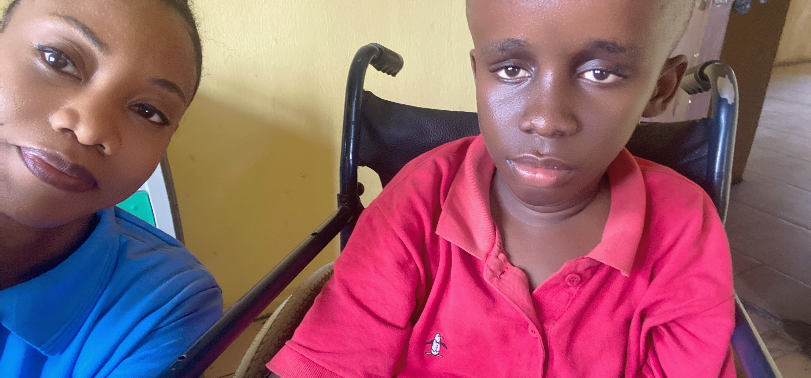

So that children
everywhere can get the assistive technology
they need

Slide 2
So that children
everywhere can get the assistive technology
they need

